Slide 1
Harford Super Kings – Find Fraud

Slide 2
Hartford Super Kings – Team members
Prabaharan Rajendran - FS_98809
Team Player - Like working with passionate tech savvy who challenges the technologies
Like doing POCs in new technologies and feel the beauty of it.
Sarthak Sahani – FS_67650
Passionate to learn new technologies
Like solving complex problem by putting effective algorithm in discrete mathematics
Like implemented things that I learnt – Pragmatic guy
Om Jha – FS_88904
Like coding! Coding! Coding! in new technologies
Like making thigs from Good to Better, Better to Best (Maximiser)
Dilip S - FS_DP1
Team Player – Working! Working! In fun environment
Technology Savvy – Keep using new gadgets and try all applications
Notes:
Python: 2.7.11 (default, Mar 1 2016, 18:40:10)
[GCC 4.2.1 Compatible Apple LLVM 7.0.2 (clang-700.1.81)]
scipy: 0.17.0
numpy: 1.10.4
matplotlib: 1.5.1
pandas: 0.17.1
sklearn: 0.18.1

Slide 3
Problem Statement with Use Case
From an insurance company point of view, it is very important for them to track fraudulent claims. Fraud can happen in many ways – one way is that for a simple ailment, the patient is hospitalized for an extended period of time.
Requirement for fraud evaluation
A medical claim is entered into the system.
Team can enter the claim input either through csv file or they can build a UI.
API will be used to accept the claim.
Then it will be validated (team has to build some validation rules).
Then it is checked against some existing fraud model to find out if the claim is a potential fraud.
Building the fraud model
Team will compile a dataset of 100 claims.
We should keep 50 fraud and 50 non-fraud items.
70% of the data should be used for training and 30% for testing.
Once the model is trained, this model is used to test the claim above.

Slide 4
Claim Data Generation
Test Dataset
Generated the 100+ claim data with around 50% of potential fraud data
70% of data is used for training and 30% data is used for testing
Below are the reference tables used for generating the claim data
Hospitals | Insurance Providers | Claim Type
Apollo | UHC | External
Kamatshi | Aetna | Internal Minor
Vadamalayan | Signa | Internal Major
Lifeline | Metlife | Maternity
 | UII | External Minor
Primary diagnosis code | Primary Diagnosis Code Description
LIEO | Leg Injury External Only
HIEO | Hand Injury ExternalOnly
LI | Leg Injury
HI | Hand Injury
Ext Only | External Only
KF | Kidney Failure Non Dialysis
CNS1 | Cancer Stage 1
CNS2 | Cancer Stage 2
CNS3 | Cancer Stage 3
CNS4 | Cancer Stage 4
HEEO | Head Injury External Only
HI | Head Injury
KFD | Kidney Failure Dialysis
PROS | Prostate Symptoms
COLA | Colateral Symptoms
CAVD | Cadi Vascular Disease
Claims code pend | Claims code pend
ICD | Incomplete Document
NMD | Need More Document
Claim Service Code | Claim Service Code Description
EX01 | External Injurty Type1
EX02 | External Injurty Type2
EX03 | External Injurty Type3
IMI1 | Internal Minor Injury Type1
IMI2 | Internal Minor Injury Type2
IMA1 | Internal Majory Injury Type1
IMA2 | Internal Majory Injury Type2
MAT | Maternity

Slide 5
UI, Fraud Model, API Development and Integration – Technologies, Approach, Solution
New screen is build for Users (Claim Handler) to choose the claim from the drop down to check the potential fraud for the respective claim
Once he/she chooses the claim, the respective claim details will be loaded. And they can run the Potential Fraud detection by clicking the submit button
User Interfaces
HTML5, CSS3
API Development & Integration
Google API is built to do the following and published into the internet,
Accept the claim
Grab & Validate data
Apply the data against the built in rules derived based on outcome of the model.
Java, Apache, Polo, Jfree, Jcommon – Published as Google API
Azure Machine Learning studio is used to do the following,
Dataset load
Visualization
Experiments
Machine learning Algorithm/existing model selection
Apply algorithm and visualize the result
Train model
Fraud Model
Azure Machine Learning Studio
Two Class Neural Network
Linear Regression

Slide 6
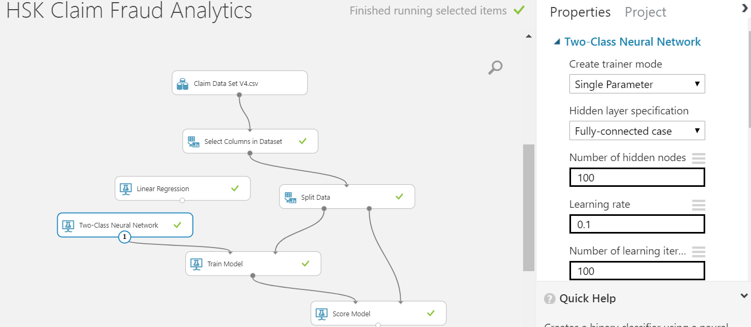
What Algorithm Used and How ?
Two Class Neural Network
Classification using neural networks is a supervised learning method, and therefore requires a tagged dataset, which includes a label column. So the claim dataset is loaded as the input to predict the binary outcomes whether or not a patent has a certain disease or not.
Model - Flow
Trained Model Output Logs
Note - Scroll the documents all the way down to see complete results

Slide 7
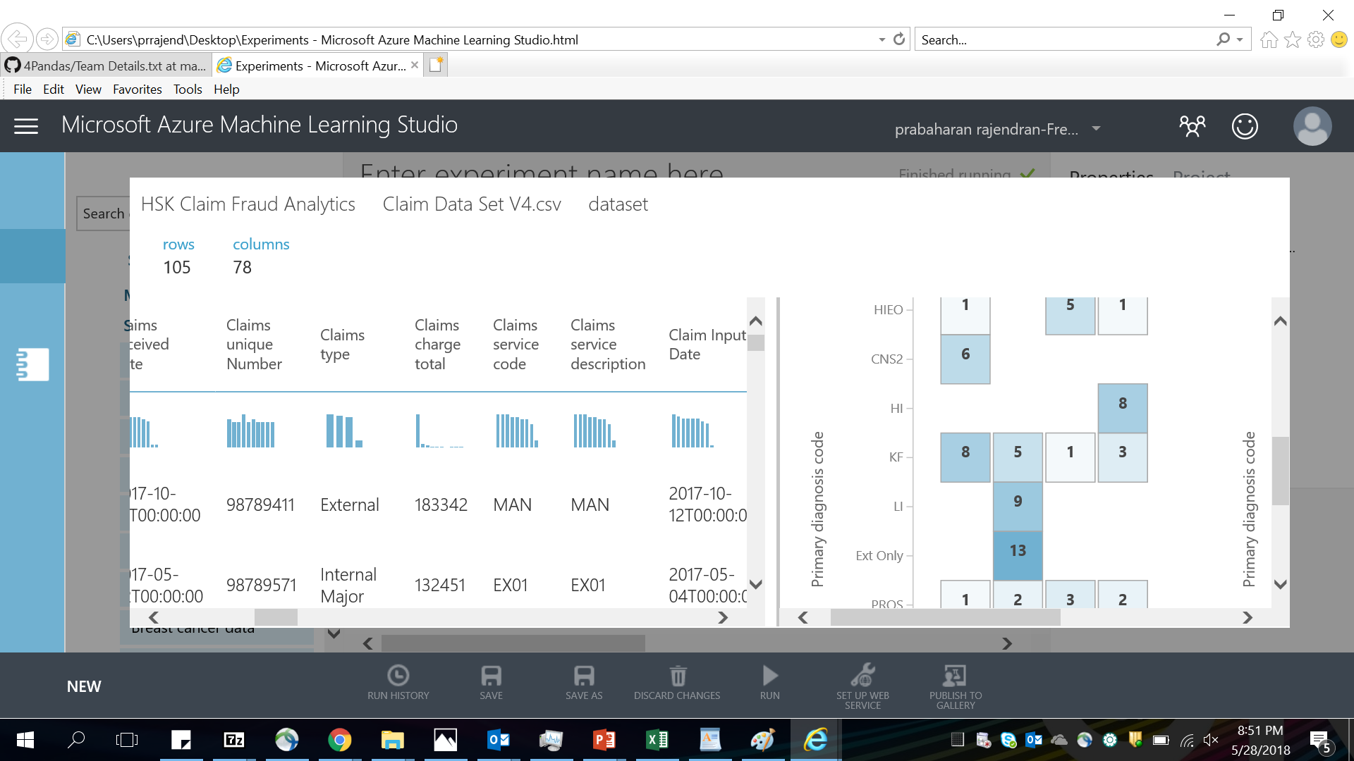
Two Class Neural Network - Visualization
Two Class Neural Network
Classification using neural networks is a supervised learning method, and therefore requires a tagged dataset, which includes a label column. So the claim dataset is loaded as the input to predict the binary outcomes whether or not a patent has a certain disease or not.
Output Screen with scoring

Slide 8
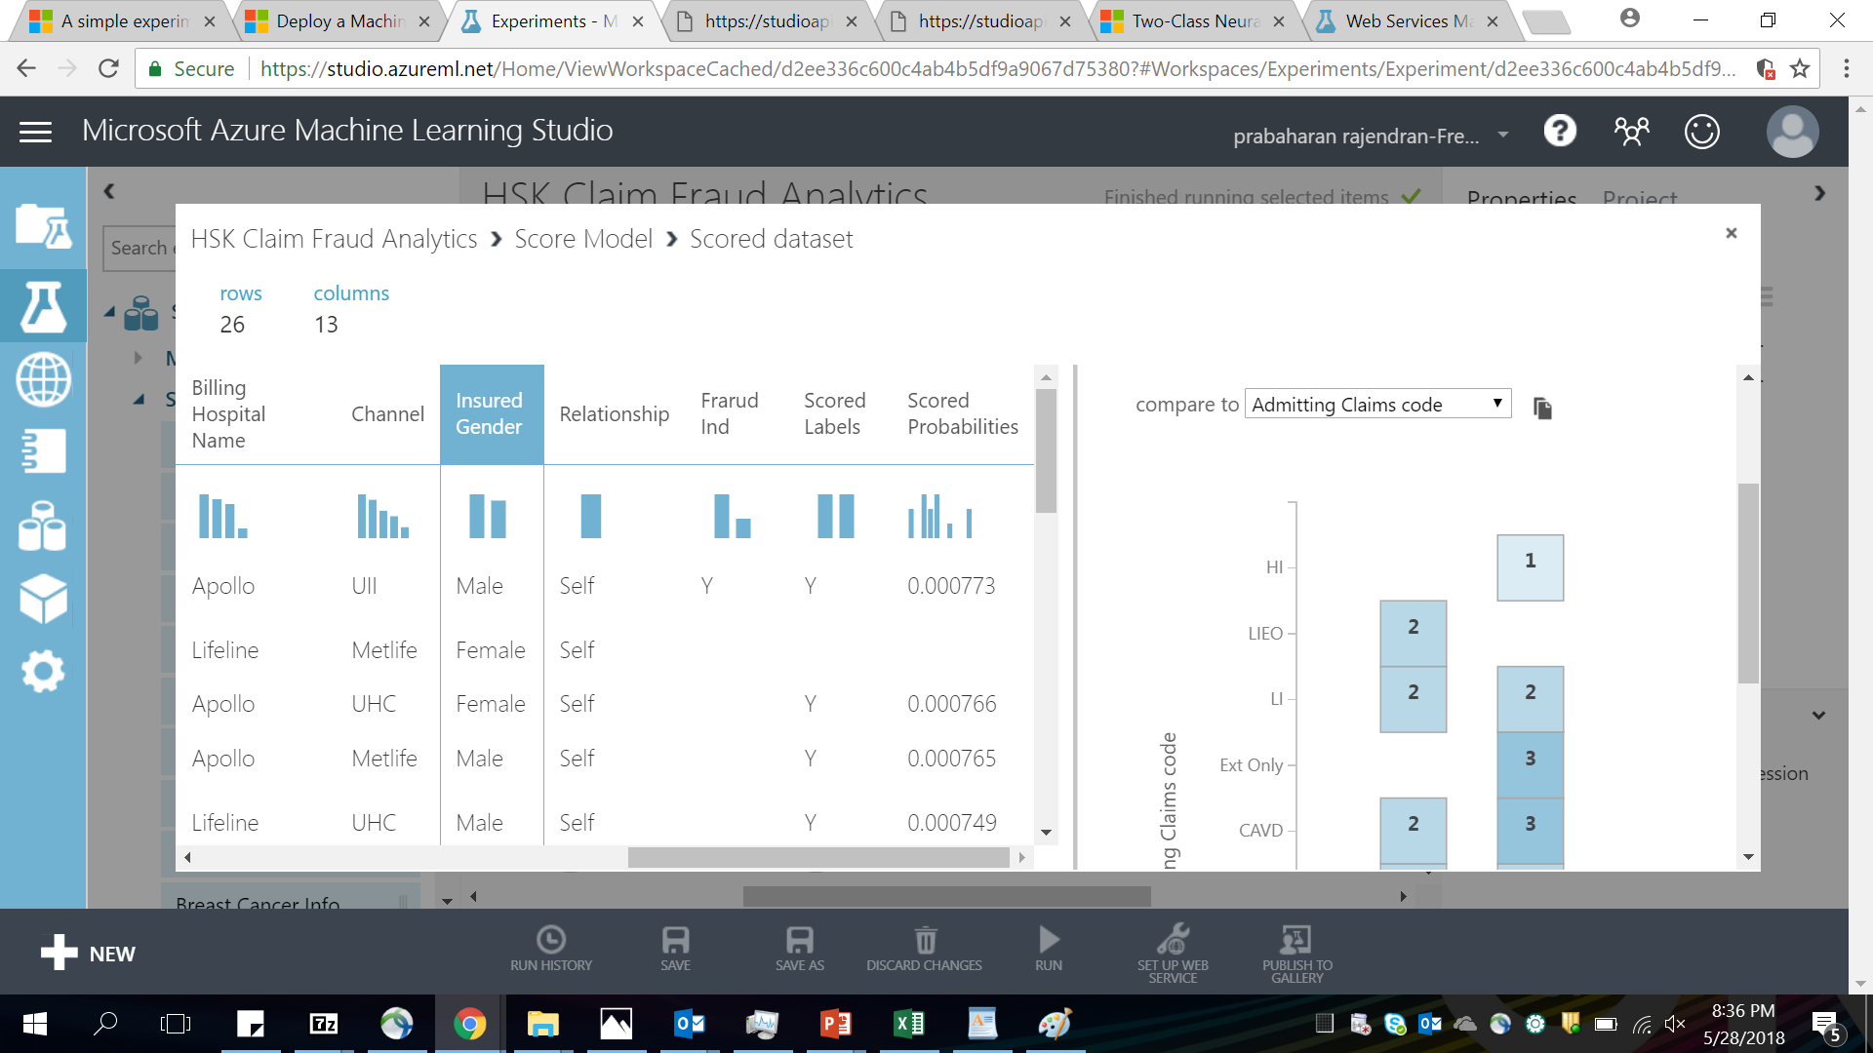
Two Class Neural Network – Output Positive
Two Class Neural Network
Classification using neural networks is a supervised learning method, and therefore requires a tagged dataset, which includes a label column. So the claim dataset is loaded as the input to predict the binary outcomes whether or not a patent has a certain disease or not.
Output Screen with scoring
Business Model Outcome
Potential Fraud 1:
PROSTRATE treatment is predominantly done for MALE patient but PROSTRATE treatment is the primary diagnosed code for the female patient Seema.
Potential Fraud 1:
Hospital Lifeline don’t have kidney treatment services but Patient Sonam’s claim type is KF with Hospital Lifeline

Slide 9
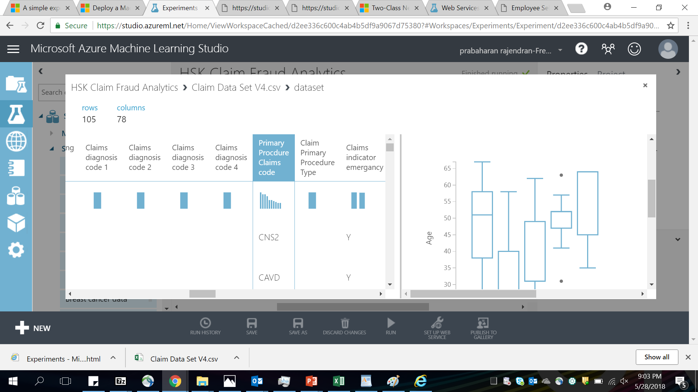
Two Class Neural Network – Output & Negative

Slide 10
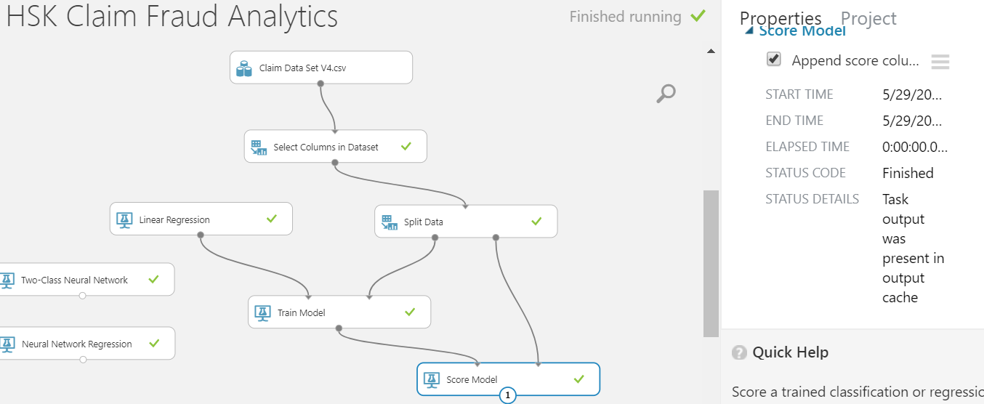
Multiple Linear Regression
Multiple Linear Regression
Multiple linear regression involves two or more independent variables that contribute to a single dependent variable. Problems in which multiple inputs are used to predict a single numeric outcome are also called multivariate linear regression. In our case, Age, Disease Type, Dragonized code and primary hospital are used as the inputs to find the potential fraud
Model - Flow
Multiple Linear Regression Visualization Output
Note - Scroll the documents all the way down to see complete results

Slide 11
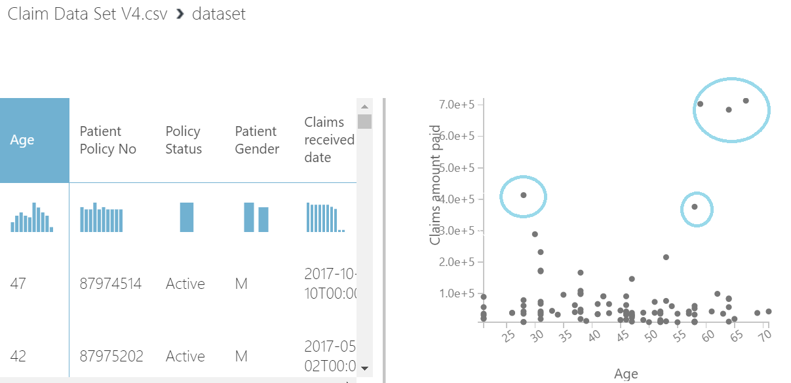
Multiple Linear Regression - Output
Multiple Linear Regression
Age, Claim amount paid are clustered to identify the potential fraud. Outliers are possible frauds
Output Screen with scoring

Slide 12
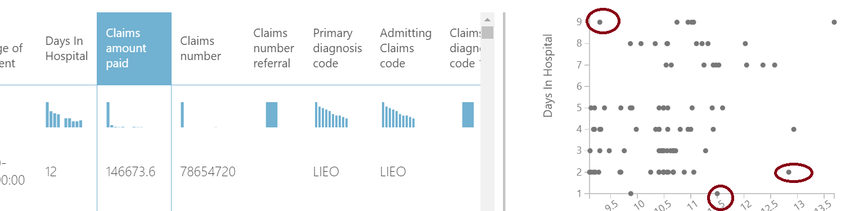
Multiple Linear Regression – Output – Positive & Negative
Multiple Linear Regression
Days in Hospital Claim amount paid are clustered to identify the potential fraud. Outliers are possible frauds
Output Screen with scoring

Slide 13
Developed Components and Location
GitHub URL
All the below details can be found in, https://github.com/prabaharanrajendranc/CapHack2018ML
Test Data
Latest Code
Test Cases & Output
Google API URL
Solution Approach

